Slide 1
Experiment 3
Standing waves
PHYS 365 & 369

Slide 2
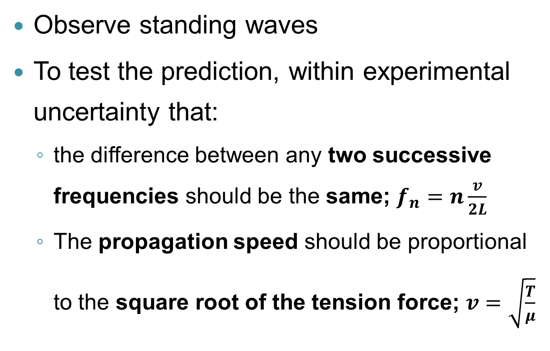
Objective
Observe standing waves
To test the prediction, within experimental uncertainty that:
  the difference between any two successive frequencies should be the same; $f_{n}=n\frac{v}{2L}$
  The propagation speed should be proportional to the square root of the tension force; $v=\sqrt{\frac{T}{μ}}$

Slide 3
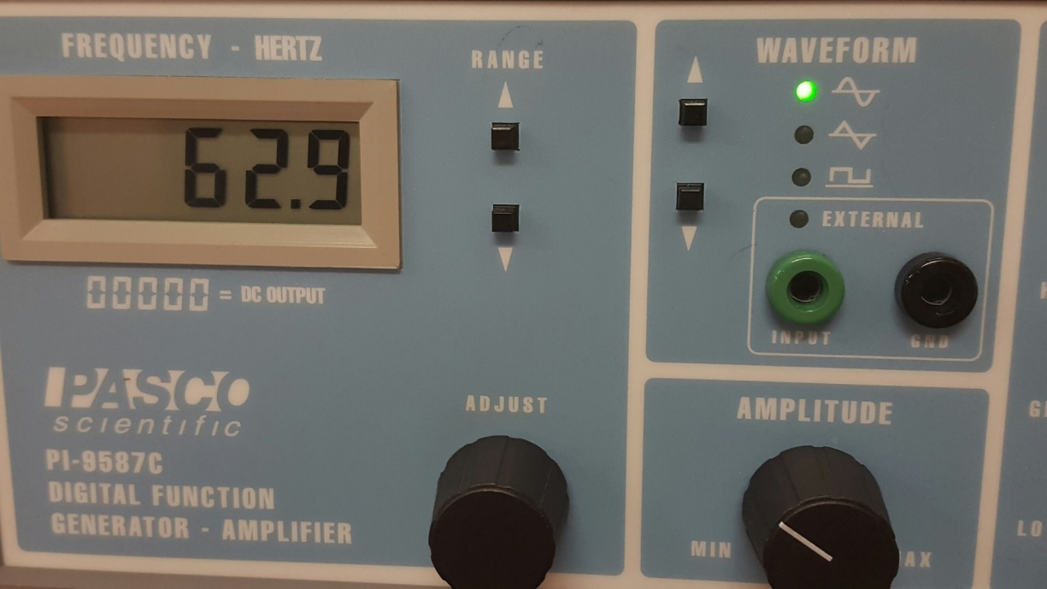
Equipment
You can adjust both frequency and amplitude/voltage.
Move slowly, the system is VERY SENSITIVE and it is easy to quickly scan past the harmonic.
There are different models (Amplitude or Voltage), if you have questions please ask your TA
amplitude
frequency

Slide 4
Tips
Be careful with the amplitude, if the wave is too large it can collide with the magnet and you can lose the wave.
Scan up slowly, then back down to verify harmonic frequency and uncertainty.
At the higher frequencies, you may not be able to see the wave, but you should be able to hear it! Listen for when the note gets the loudest to find your frequency.

Slide 5
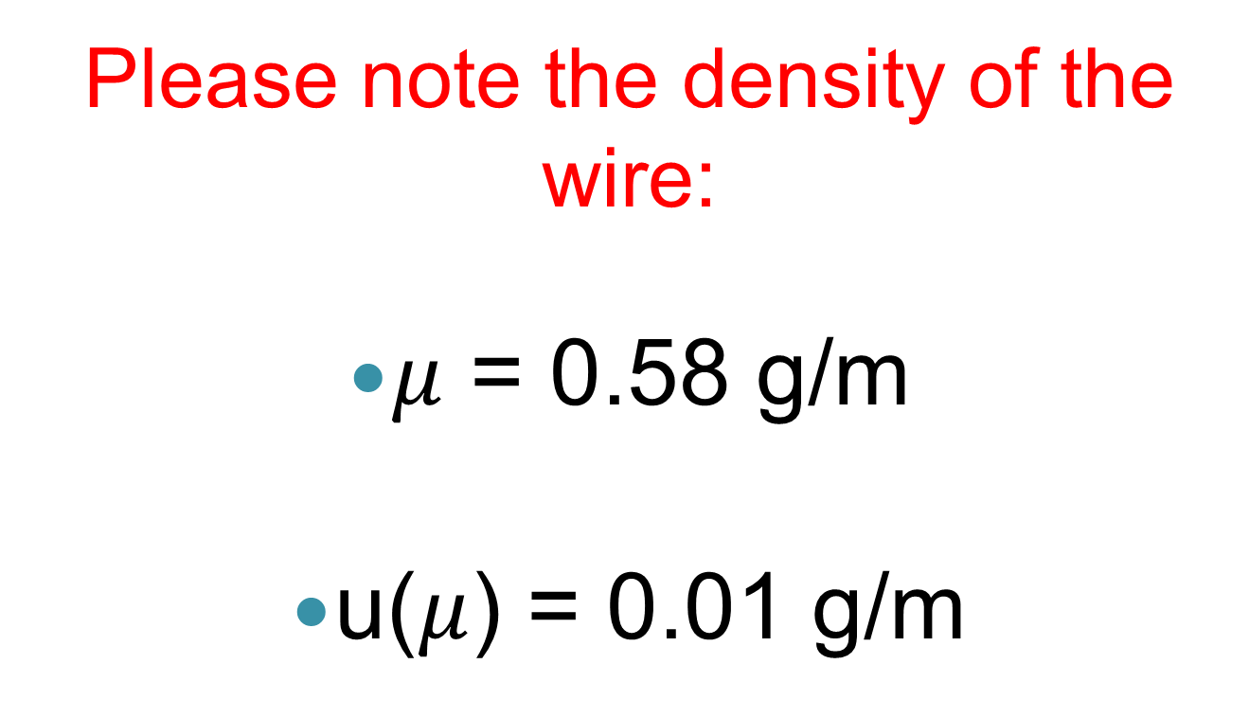
Linear density of the wire
Please note the density of the wire:
$μ$ = 0.58 g/m
u($μ$) = 0.01 g/m

Slide 6
Procedure
Part 1:
Hold the tension constant and vary the harmonic number
Record the frequency which produces a
maximum amplitude standing wave for each of the modes.
Estimate the uncertainty in the frequency by adjusting f to reduce the amplitude by 50% ( for the modes you can see, n=1-8)
Notes:
In order to estimate the uncertainty in fn , find the difference between
the frequency when the amplitude of the standing wave is at
its maximum and when the amplitude is reduced to half of its maximum
value.
For the modes you can see. At least 8 points

Slide 7
Procedure
Part 2:
Find the frequency for the fundamental mode (n=1) for various different tension values.
Record the frequency which produces a
maximum amplitude wave at varying tensions values.
Again, estimate the uncertainty in the frequency by adjusting f to reduce the amplitude by 50%

Slide 8
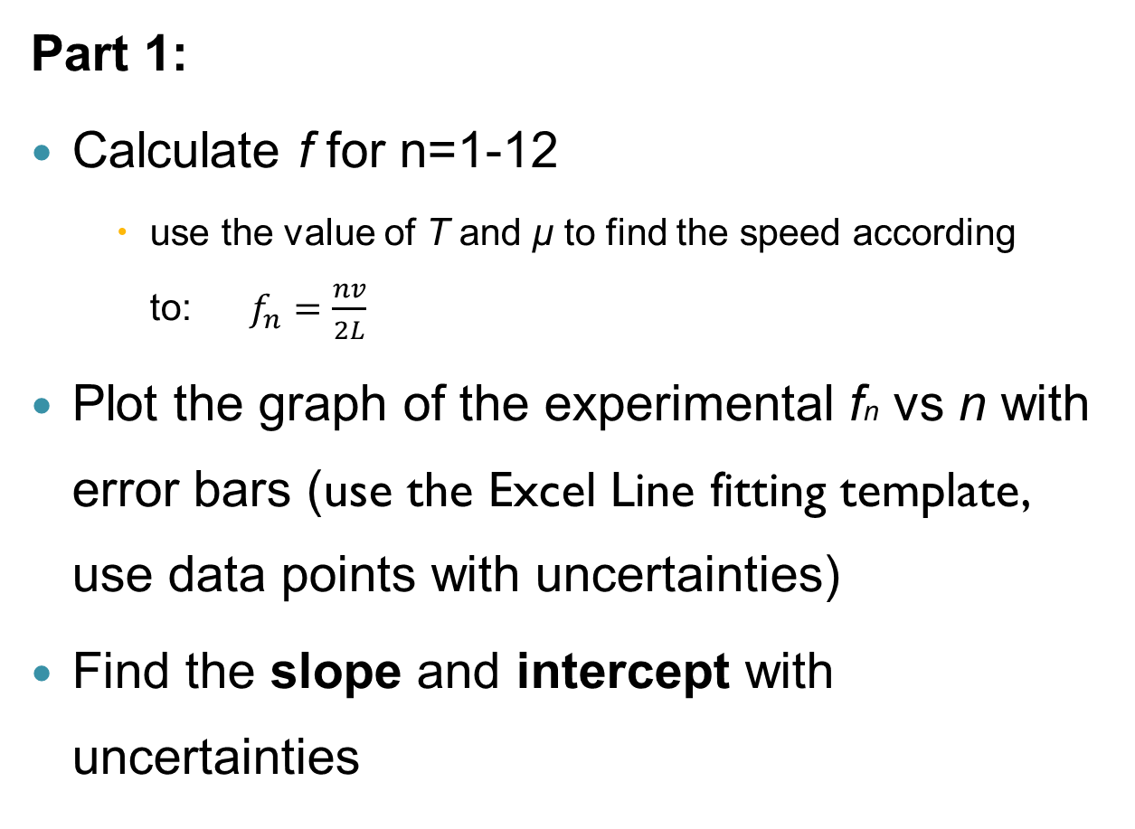
Analysis
Part 1:
Calculate f for n=1-12
    use the value of T and μ to find the speed according to:$f_{n}=\frac{nv}{2L}$
Plot the graph of the experimental fn vs n with error bars (use the Excel Line fitting template, use data points with uncertainties)
Find the slope and intercept with uncertainties
Notes:
Use the Excel Line fitting template with uncertainties

Slide 9
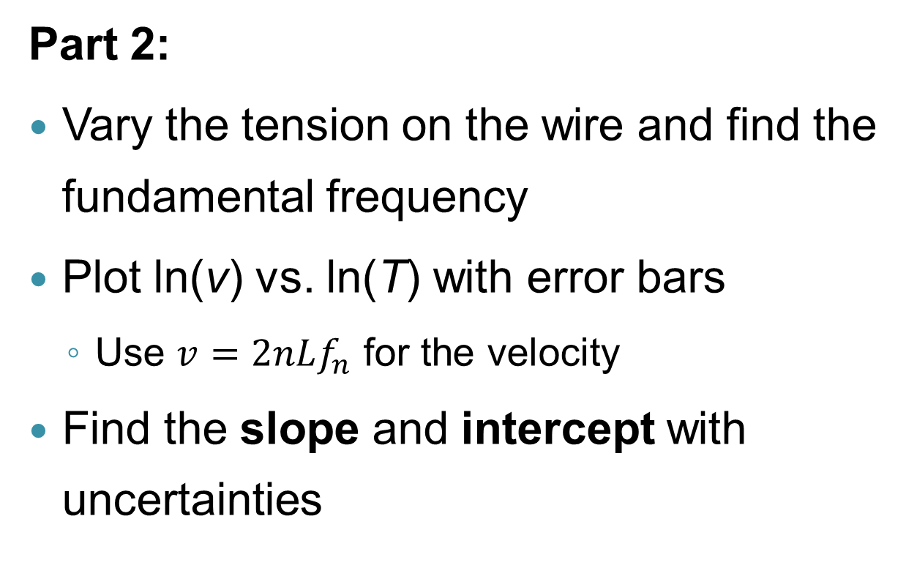
Analysis
Part 2:
Vary the tension on the wire and find the fundamental frequency
Plot ln(v) vs. ln(T) with error bars
  Use $v=2nLf_{n}$ for the velocity
Find the slope and intercept with uncertainties

Slide 10
Discussion
Part 1:
Compare the value of slope with the calculated value
Part 2:
Compare the value of the slope with 0.5 (the number has no uncertainty)
Compare the value of the intercept with –0.5ln(μ) with its estimated uncertainty
Notes:
Part1(f vs n): Separately, calculate the speed as v =sqrt(T/μ), and use the measured value of L to calculate the expected
value of the slope. Then compare the experimental value of the slope with the expected value
Part2 (ln(v) vs ln(T)): expected slope= 0.5

Slide 11
Before you leave
Have a graph for Part 1 plotted
Ideally, finish both graphs
Make sure you know how the uncertainties are calculated for this lab report

Slide 12
Laboratory report
Title of experiment, date, partners’ names, TA’s name, lab section, group number
Objective
Theory (brief with equations)
Method
Data (Tables)
Analysis (Graphs)
Discussion
Conclusions

